Slide 1

Python & Data Science Training Project 5 – Mortgage Default Model & Mortgage Prepayment Model

Slide 2
Contents
Link to the data
What we are going to learn in 4 weeks
week 1: machine learning
week 2: logistic regression & K-means clustering
week 3:ANN and CNN of deep learning
week 4: Survival analysis
The problem of overfitting
Experimental design for building a predictive model
IV. Key knowledge not covered but you need to gain

Slide 3
I. Link to the file for the project
- We will be using mortgage data to build multiple predictive models throughout this project.
Link to the data:
https://1drv.ms/u/s!Amfo1lixPzv-j3k_230kv-58OmZW?e=x5WIz8

Slide 4
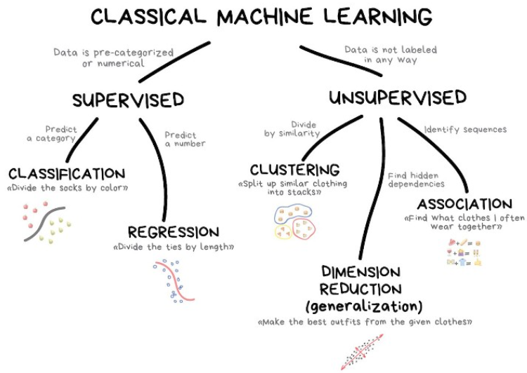
II. What we are going to learn from this project
Deep learning:
- Artificial Neural Network (ANN)
- Convoluted Neural Network (CNN)
Survival Analysis
It will generate a probability estimate for each month.
Logistic regression
Decision tree
Naïve Bayes
Gradient descent
KNN
Light Gradient Boosting
XGBoost
Random Forest
Ensemble method

Slide 5
Week 1: Machine Learning
Use multiple machine learning methods to build
Mortgage payment default model (which customers are more likely to fail to pay)
Prepayment model (which customers are more likely to prepay their mortgage
Prepayment:
- Involuntary prepayment
- A homeowner fails to make payment for consecutive 6 months.
- Voluntary prepayment
- A homeowner sells his/her house.
- A homeowner refinances his/her house
Skills gained in this exercise can be applied to such tasks as marketing campaign response modeling and fraud detection.

Slide 6
Suggestions for improving machine learning models
Use a different set of predictors for prepayment than that for payment default because the two outcomes could be driven by different factors.
For each ML algorithms, choose a different set of predictors. However, this will increase the complexity of the codes as you need to customize the evaluation function for each algorithm.

Slide 7
Week 2: Logistic regression K-means clustering
Logistic regression for an underwriting model
This is the most important skill for risk management/control in almost all companies that issues credit card
or various kinds of loans (student loans, car loans, personal loans and mortgages, etc.)
Underwriting: decline of approval of a loan/credit application
May machine learning algorithms perform better than logistic regression. Why still logistic regression?
- Most machine learning methods generate black-box algorithms that are explainable, but logistic regression can explain which factors causes the outcome and to what degree. In order to meet audit or compliance requirements, many models need to offer the contributing factors to an outcome of interest.
- Underwriting in the US are subject to laws to fair lending to prevent discrimination. A company needs to provide reasons when declining a loan/credit applications.
K-means clustering to segment customers.
Skills gained in this exercise can be applied to such modeling tasks as marketing campaign response models and fraud detection.

Slide 8
Week 3: Deep learning
Use Artificial Neural Network (ANN) & Convoluted Neural Network (CNN) to build
Mortgage default model (which customers are more likely to fail to pay)
Prepayment model (which customers are more likely to prepay their mortgage
Prepayment:
- Involuntary prepayment
- A homeowner fails to make payment for consecutive 6 months.
- Voluntary prepayment
- A homeowner sells his/her house.
- A homeowner refinances his/her house
Skills gained in this exercise can be applied to such tasks as marketing campaign response modeling and fraud detection.

Slide 9

Week 4: Survival Analysis - Kaplan Meier Curve - Cox Proportional Hazards Model
Use Survival Analysis to approach
Mortgage default (which customers are more likely to fail to pay)
Prepayment (which customers are more likely to prepay their mortgage
Prepayment:
- Involuntary prepayment
- A homeowner fails to make payment for consecutive 6 months.
- Voluntary prepayment
- A homeowner sells his/her house.
- A homeowner refinances his/her house
Survival analysis not only gives the probability estimate of the event of interest along different periods in time, e.g., by month.
It can be applied to any time-of-life analysis such as attrition analysis, time-to-failure modeling, etc.

Slide 10
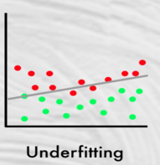
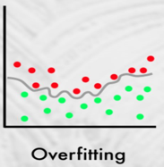
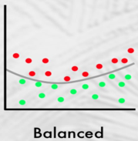
III. The problem of overfitting Let’s start with a not-so-good analogy : What are the typical physical traits of East Asians and Southeast Asians?
This question appears in every DS interview.
black hair, black eyes
Problem: correct description, but too general and hence useless. It describes many people of different races, including many non-Asians.
In the US, if you apply this description, most people selected will be non-East-Asian, given that the latter is a small portion in population.
Black hair, black eyes, light brown and smooth skin, less body hair, thin lips, height between 5.5 feet and 5.9 feet, speak softly,......
Problem: too specific and too detailed. The description loses generality that it only describes a small portion of Asian.
Black hair, black eyes, light brown and smooth skin, less body hair
A model cannot escape errors.
Some non-Asians will be included (false positive)
Some Asians will be excluded (false negative)
We want to reduce or minimize the errors. The description tries to cover as many East Asian as possible while excluding as many non-Asians as possible at the same time.

Slide 11
Diagnosis of overfitting
Cause:
Modelers often have the tendency of maximizing the use of data in order to build the best model. This could easily cause overfitting.
Overfitting: The model describes the sample too well that it loses generality in prediction.
Symptom of overfitting:
The accuracy rate drops considerably
Modeling sample: 96%
Validation sample: 75%
Remedy for overfitting:
Consistent performance from modeling sample to validation sample is an effectively way to reduce overfitting.
When a model over-explains the noise, it causes overfitting.
Build a theory/model based on the modeling sample
Test the theory/model on the validation sample
Consistent performance proves that the theory/model works.
Overfitting is often associated with:
Too many variables in the model.
Variables too similar in nature (multicollinearity).
Sample too small.
Algorithm too complex and convoluted.

Slide 12
III. Experimental design for building a predictive model
If the sample comprises of data from different periods.
If there are no differences in impactful events or major policy changes between two periods.
Most common approach
Example: train_test_split in scikit learn
modeling sample
(60% - 80%)
generate an algorithm
modeling sample
(early period)
generate an algorithm
a sample
Randomly split to
a sample
split to
two periods
Apply algorithm on
Apply algorithm on
validation sample
(20% - 40%)
validation sample
(late period)

Slide 13
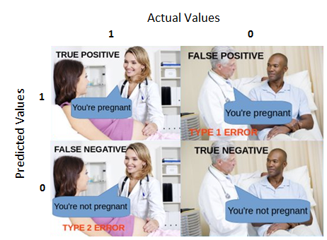
IV. Key knowledge not covered but you need to gain for building a classification model
Common metrics used for evaluating a classification model:
- Precision
- Accuracy
- Recall
- F1 Score
Check tutorials online to learn more about the above.

